Slide 1
Make basis set with MRS cloud

Slide 2
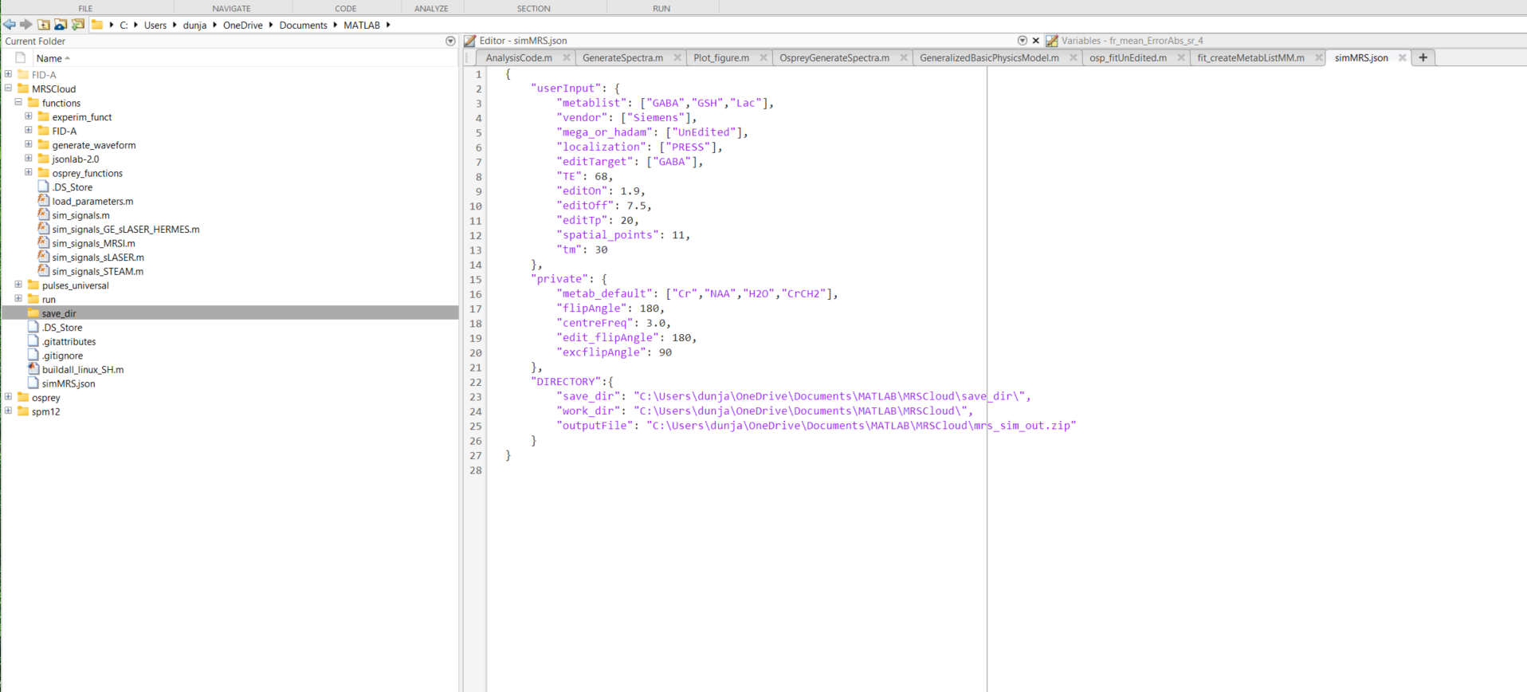
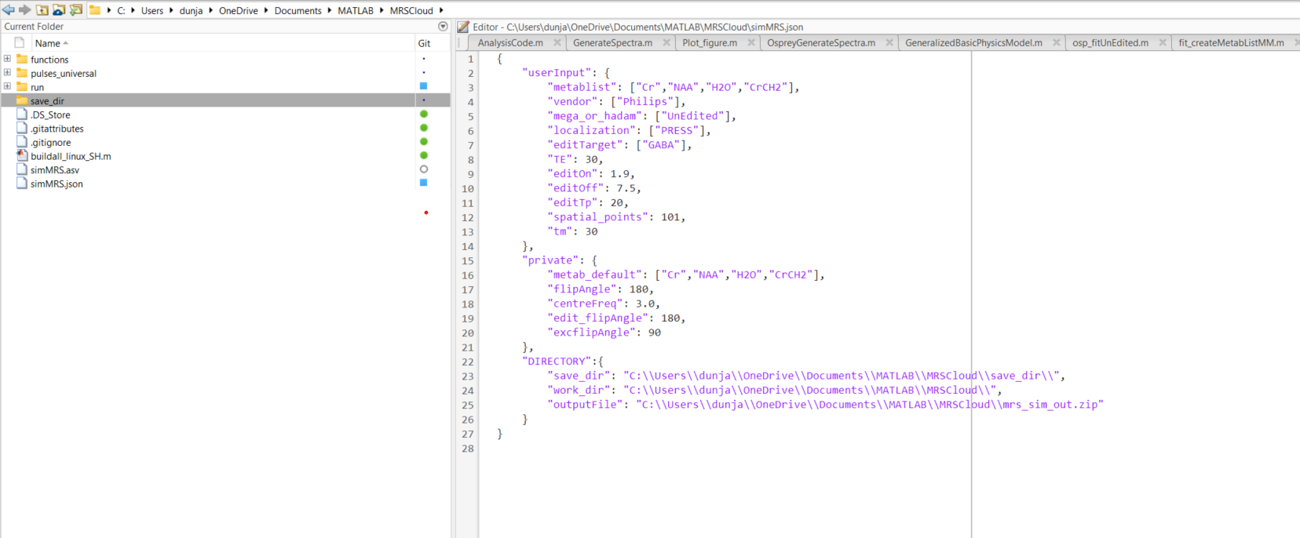
1. In Run change the json file
Default parameters
Double slash in json only

Slide 3
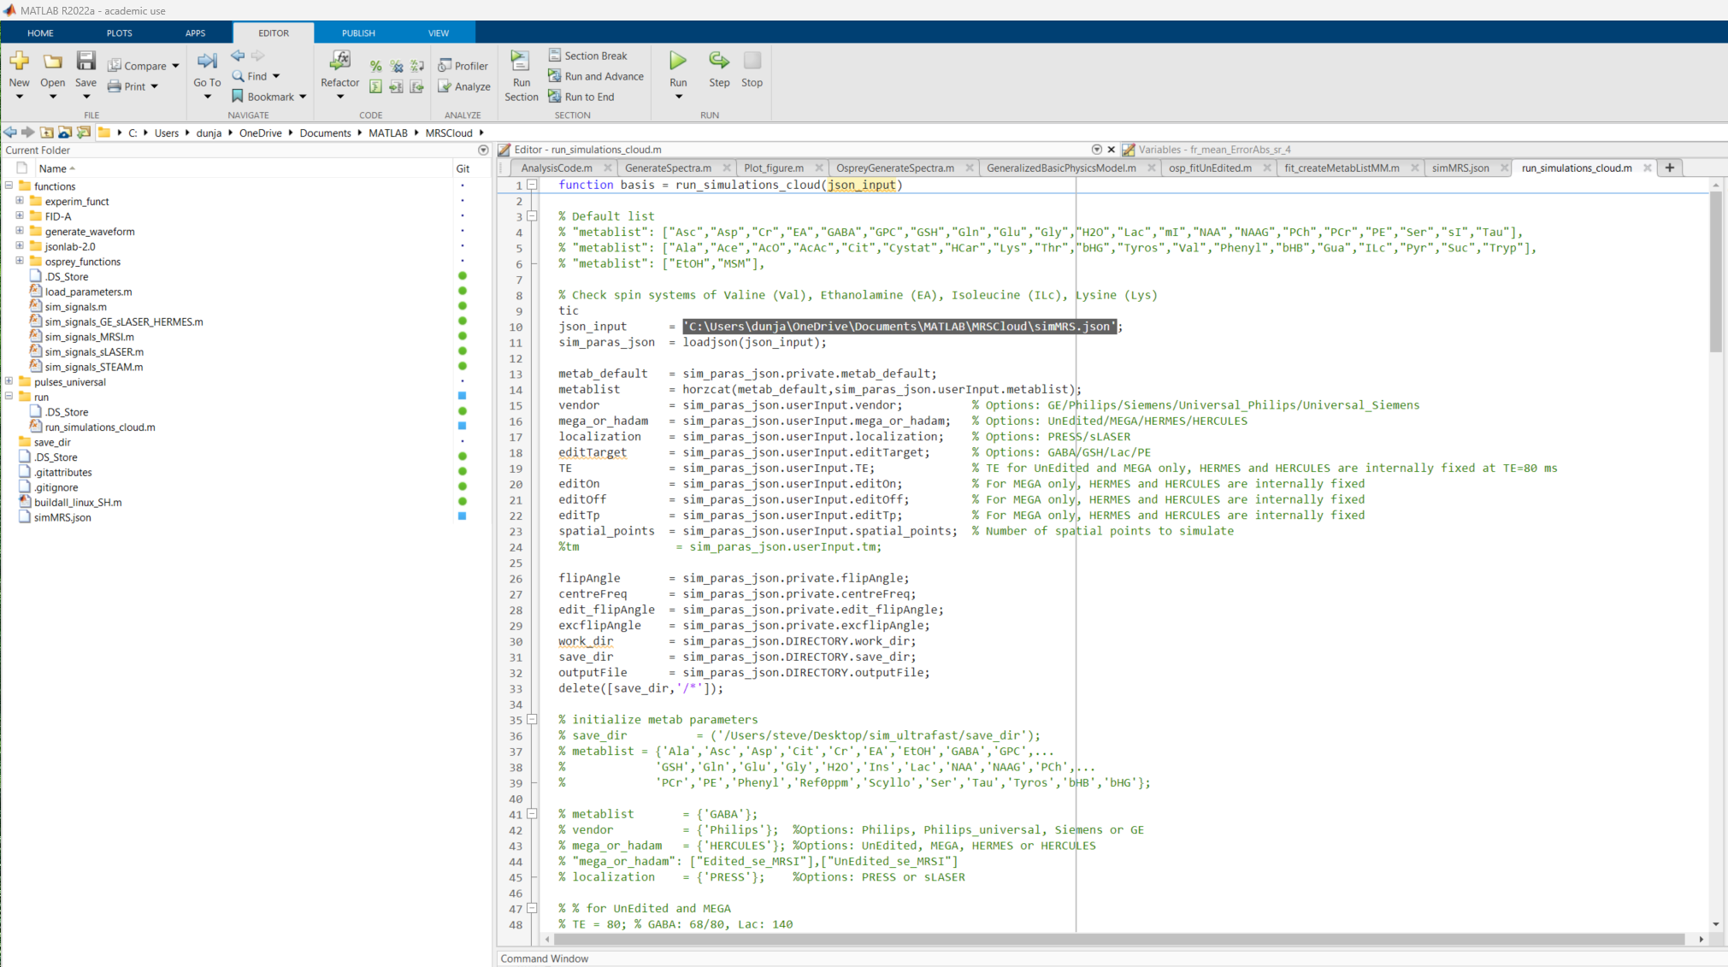
Command line:
>> basis = run_simulations_cloud('C:\Users\dunja\OneDrive\Documents\MATLAB\MRSCloud\simMRS.json')

Slide 4
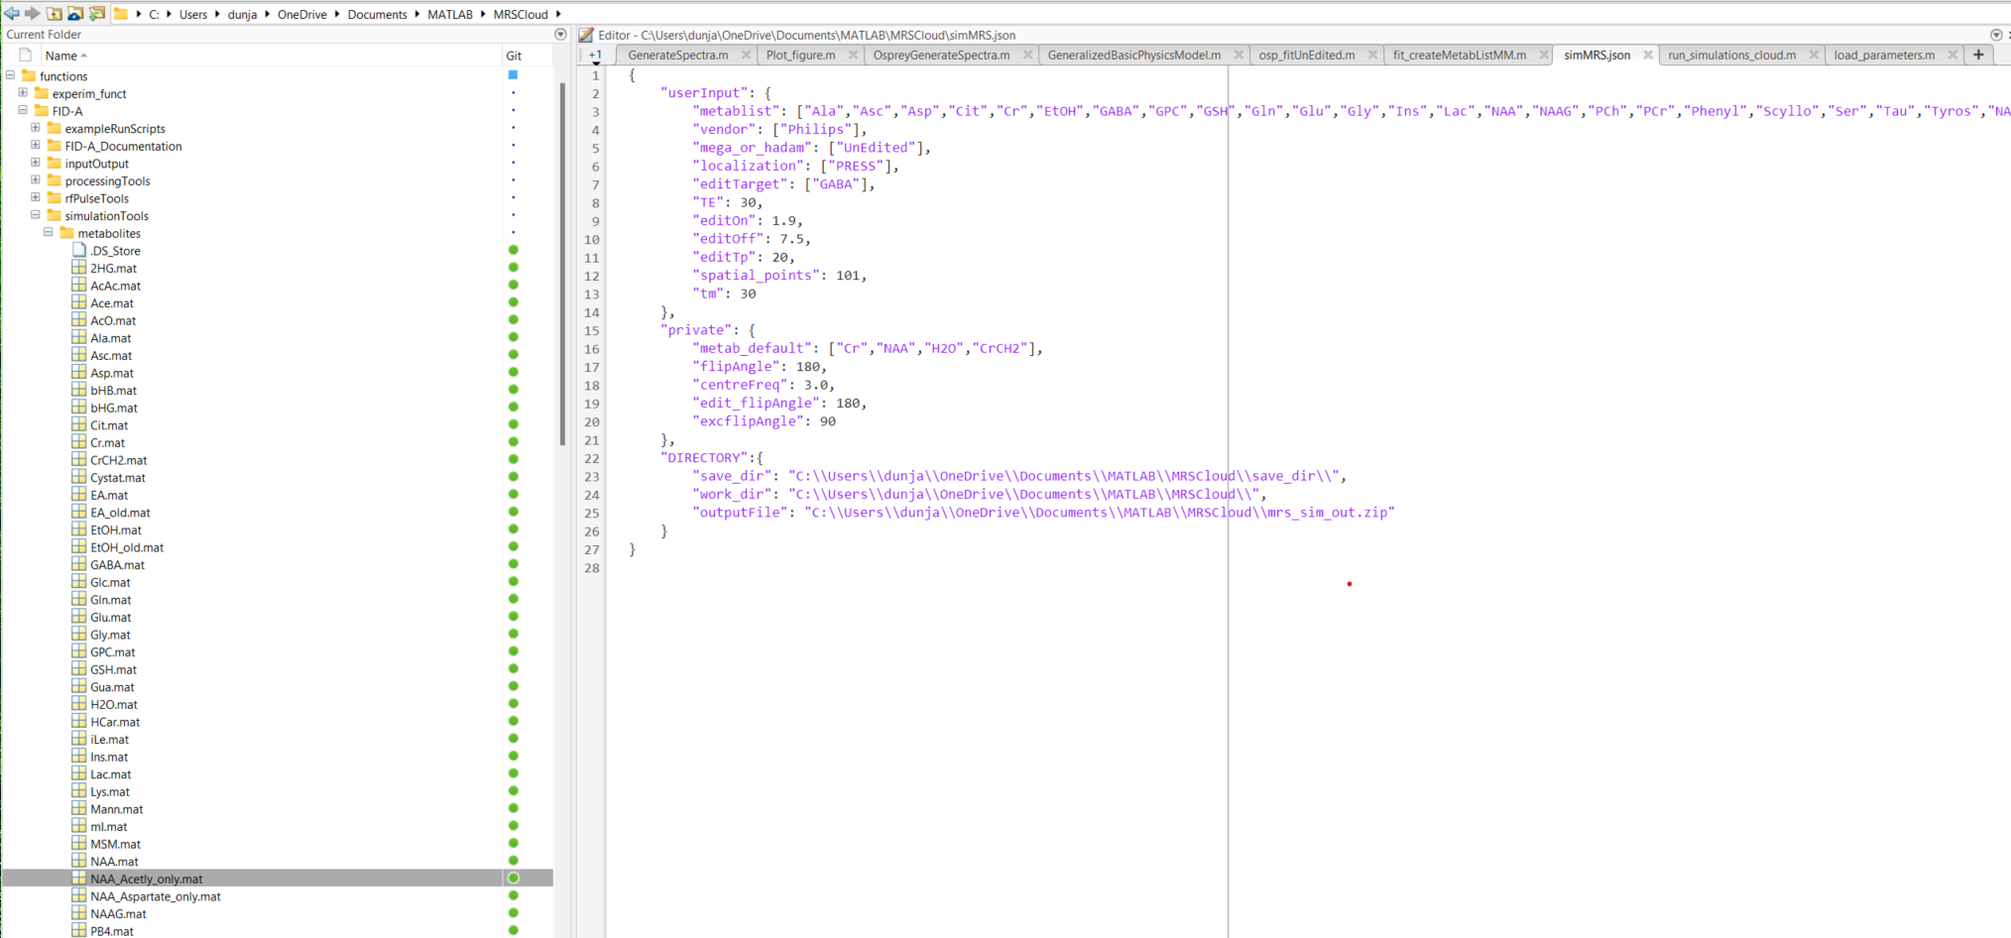
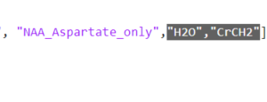
Need the two of the default as well

